Slide 1
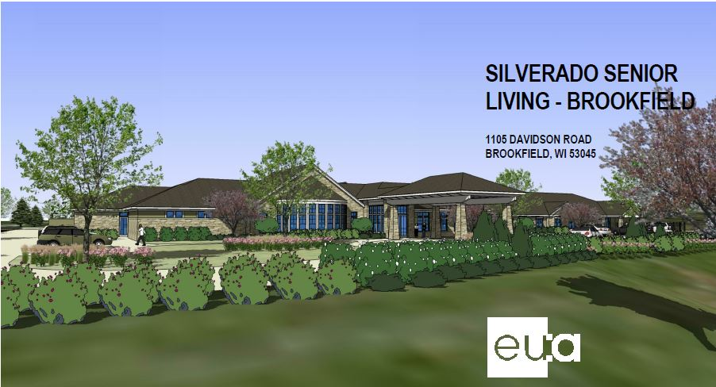


Silverado Senior Living
Brookfield, Wisconsin
Analysis Topics
On-site Prefabrication of Interior Wall Panels
Installation of Solar Panels
SIPS for Resident Rooms
Re-sequencing of the Project Schedule
Breadth Topics
Electrical
Electrical design and modifications needed for solar panel installation
Structural
Structural design and modifications needed to support additional load from solar panels
Silverado Senior Living
Brookfield, WI
*Courtesy of Hunzinger
Presented by Cameron Mikkelson April 16, 2014

Slide 2
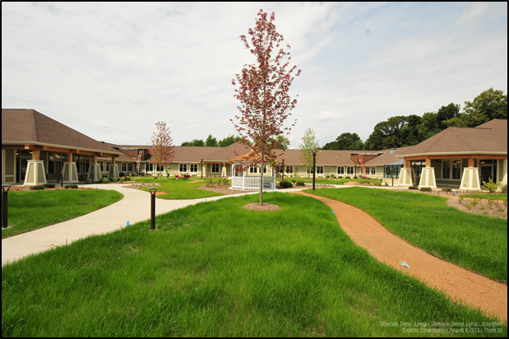
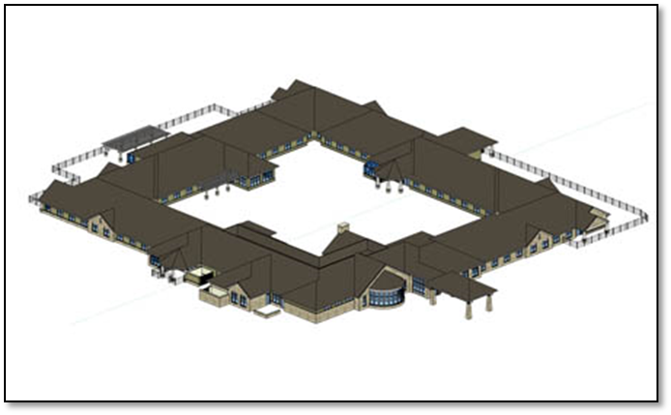
Presentation Outline
Project Overview
Analysis 1: Prefabrication
Analysis 2: Solar Panel Installation
  Electrical Breadth
Analysis 3: SIPS
Analysis 4: Re-sequencing Project Schedule
Conclusion and Acknowledgements
Appendix
*Courtesy of Hunzinger
*Courtesy of Hunzinger

Slide 3
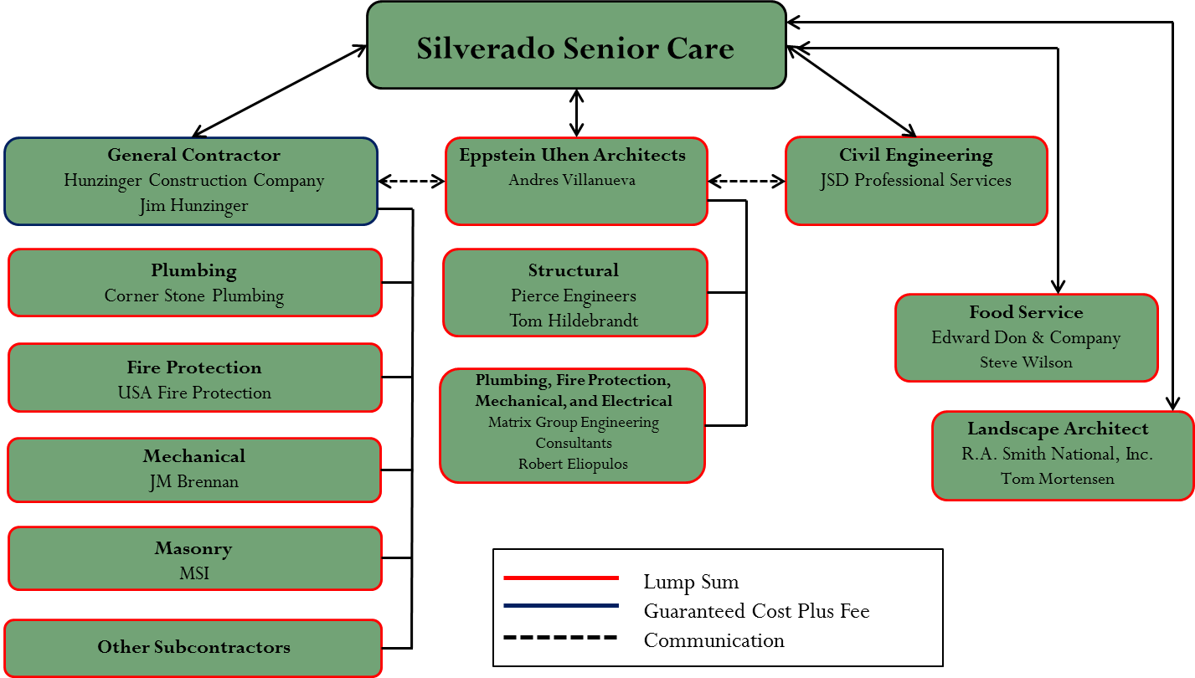
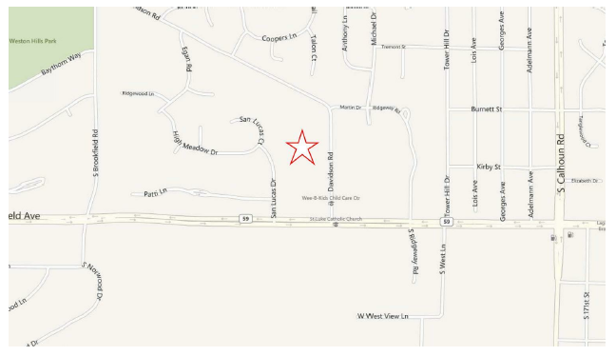
Project Overview
Project Overview
Analysis 1: Prefabrication
Analysis 2: Solar Panel Installation
  Electrical Breadth
Analysis 3: SIPS
Analysis 4: Re-sequencing Project Schedule
Conclusion and Acknowledgements
Appendix
*Courtesy of Hunzinger

Slide 4
Project Overview
Project Overview
Analysis 1: Prefabrication
Analysis 2: Solar Panel Installation
  Electrical Breadth
Analysis 3: SIPS
Analysis 4: Re-sequencing Project Schedule
Conclusion and Acknowledgements
Appendix
Design Goal
Explore alternative, cost effective methods of construction to ultimately reduce field installation time.

Slide 5
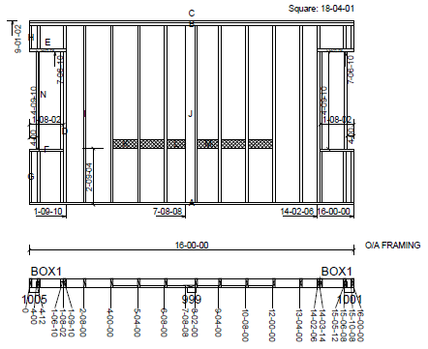
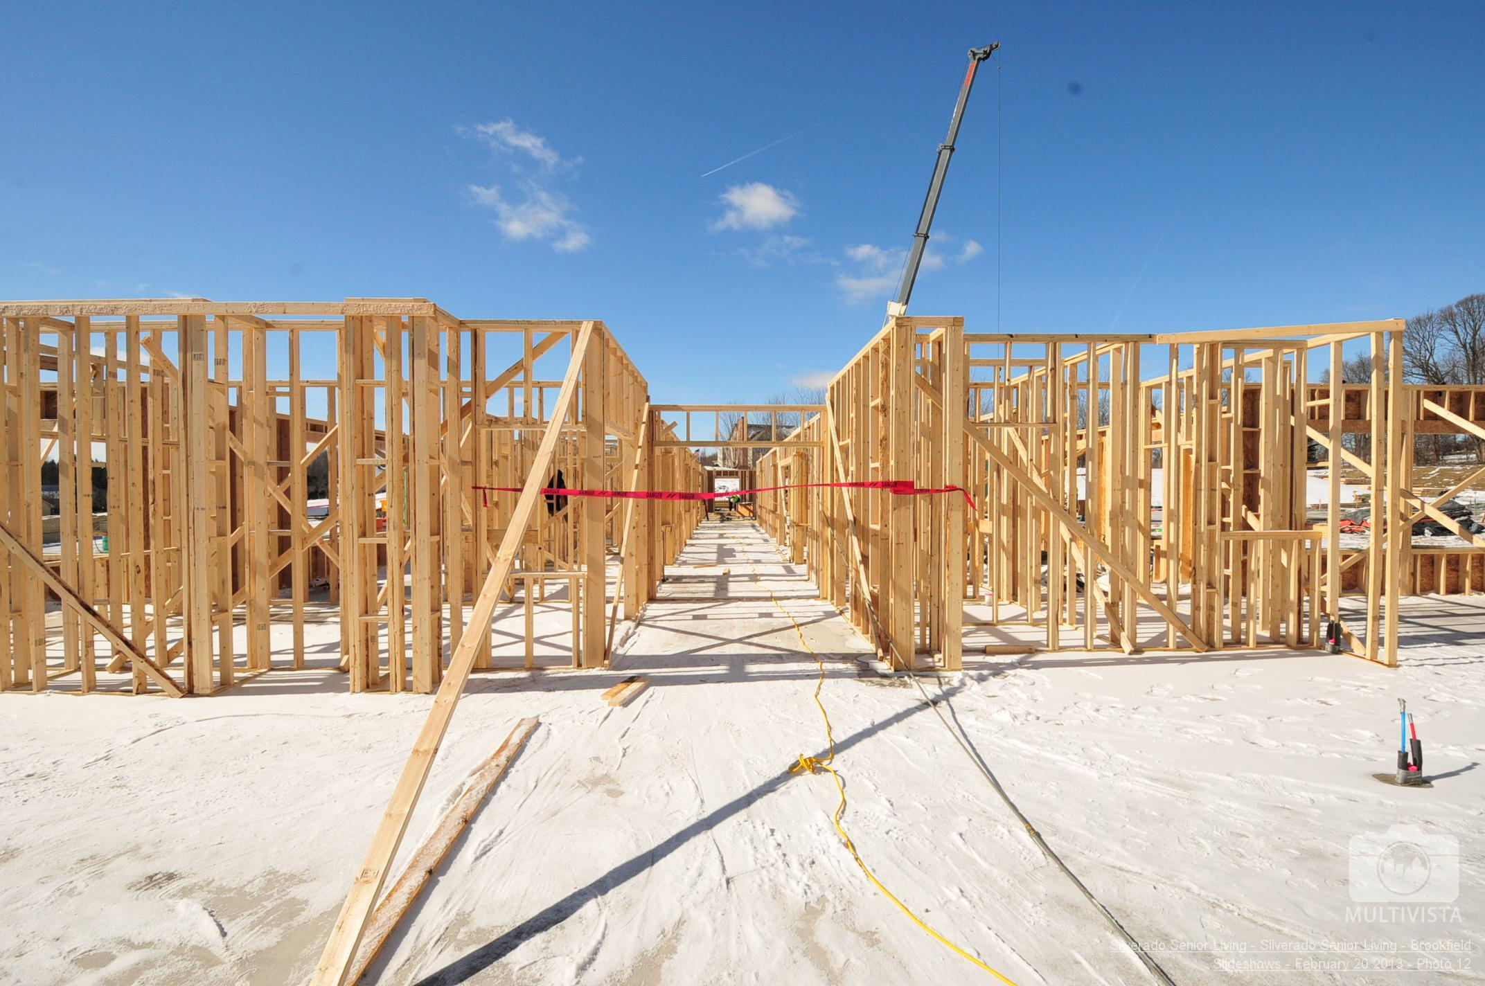
Prefabrication of Interior Wall Panels
Project Overview
Analysis 1: Prefabrication
Analysis 2: Solar Panel Installation
  Electrical Breadth
Analysis 3: SIPS
Analysis 4: Re-sequencing Project Schedule
Conclusion and Acknowledgements
Appendix
*Courtesy of Hunzinger
*Courtesy of Hunzinger

Slide 6
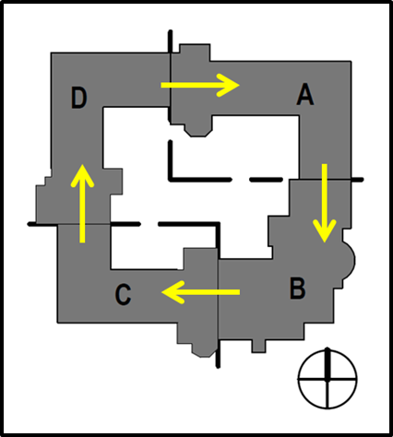
Prefabrication of Interior Wall Panels
Project Overview
Analysis 1: Prefabrication
Analysis 2: Solar Panel Installation
  Electrical Breadth
Analysis 3: SIPS
Analysis 4: Re-sequencing Project Schedule
Conclusion and Acknowledgements
Appendix
Background Information
143 interior wall panels
Wood stud framing
Panel installation 34 days
Plumbing rough-in 35 days
4 quadrants divided into 3 panel deliveries
Interior courtyard
*Courtesy of Hunzinger

Slide 7
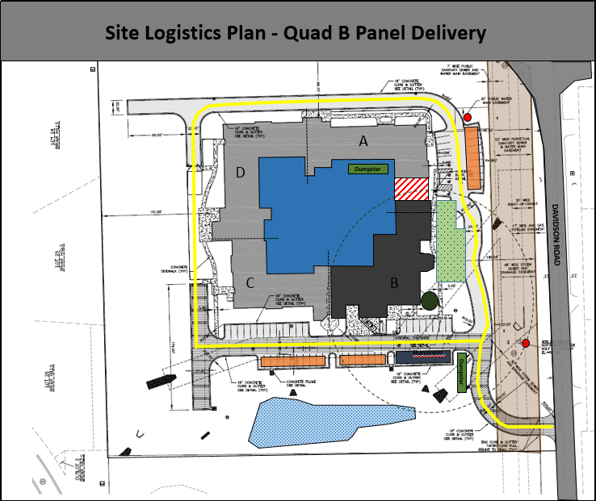
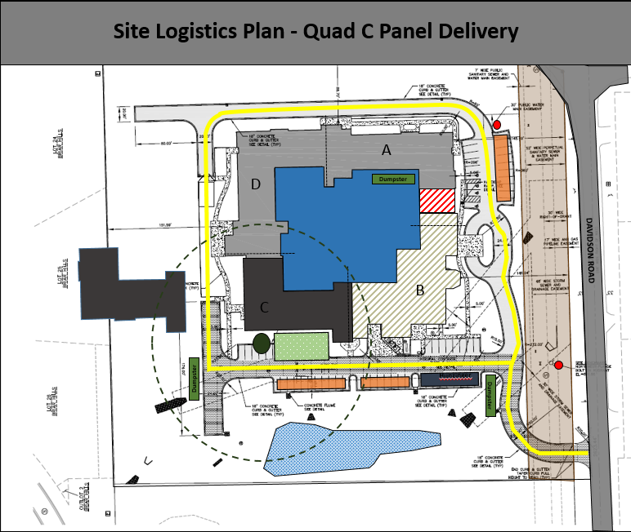
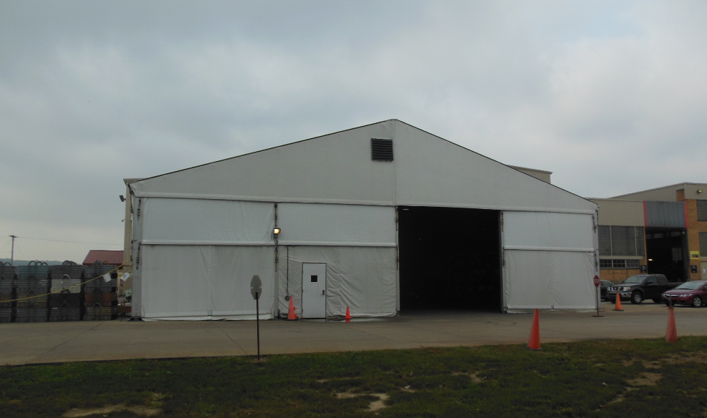
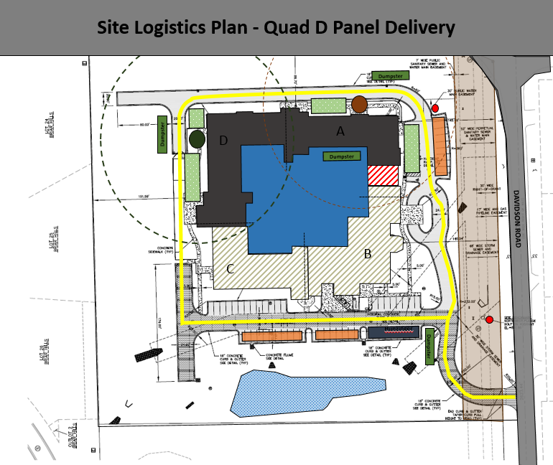
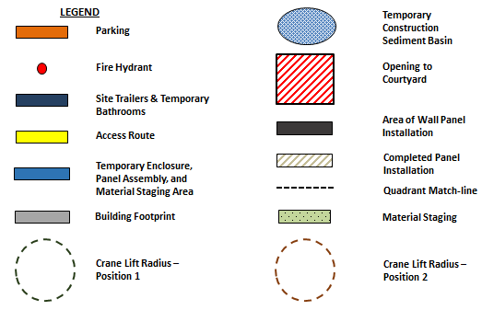
Prefabrication of Interior Wall Panels
Project Overview
Analysis 1: Prefabrication
Analysis 2: Solar Panel Installation
  Electrical Breadth
Analysis 3: SIPS
Analysis 4: Re-sequencing Project Schedule
Conclusion and Acknowledgements
Appendix
Prefabrication Location and Temporary Enclosure
66’ x 82’ Mega Structure from Mahaffy
$40,745
Delivery, install, 3-month rent, takedown
*Courtesy of Mahaffy Fabric Structures
*Courtesy of Hunzinger

Slide 8
Prefabrication of Interior Wall Panels
Project Overview
Analysis 1: Prefabrication
Analysis 2: Solar Panel Installation
  Electrical Breadth
Analysis 3: SIPS
Analysis 4: Re-sequencing Project Schedule
Conclusion and Acknowledgements
Appendix
Panel Assembly and Installation
Reduced schedule by 13 days
Constructability Concerns
Coordination with panel supplier
Scheduling
Spatial considerations for temporary enclosure
Protection of existing work
Field Issues

Slide 9
Prefabrication of Interior Wall Panels
Project Overview
Analysis 1: Prefabrication
Analysis 2: Solar Panel Installation
  Electrical Breadth
Analysis 3: SIPS
Analysis 4: Re-sequencing Project Schedule
Conclusion and Acknowledgements
Appendix
Results
Schedule reduction: 13 days
Additional expenses: $84, 457
Safety
Quality control and logistical issues
Cost Breakdown

Slide 10
Prefabrication of Interior Wall Panels
Project Overview
Analysis 1: Prefabrication
Analysis 2: Solar Panel Installation
  Electrical Breadth
Analysis 3: SIPS
Analysis 4: Re-sequencing Project Schedule
Conclusion and Acknowledgements
Appendix
Conclusion and Recommendation
Do not utilize prefabrication as a means of achieving a reduction in schedule.

Slide 11
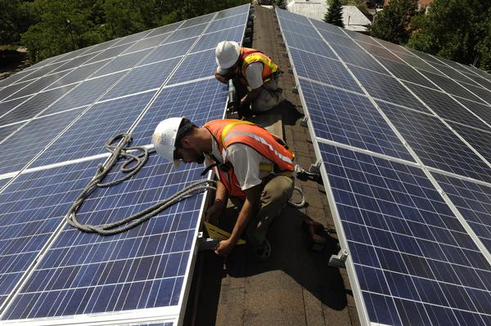
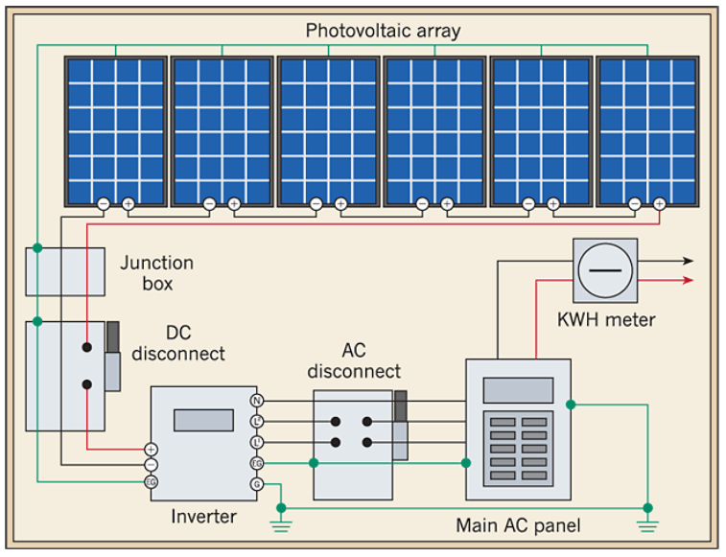

Installation of Solar Panels
Project Overview
Analysis 1: Prefabrication
Analysis 2: Solar Panel Installation
  Electrical Breadth
Analysis 3: SIPS
Analysis 4: Re-sequencing Project Schedule
Conclusion and Acknowledgements
Appendix
www.solren.com
www.ecmweb.com
www.solren.com

Slide 12
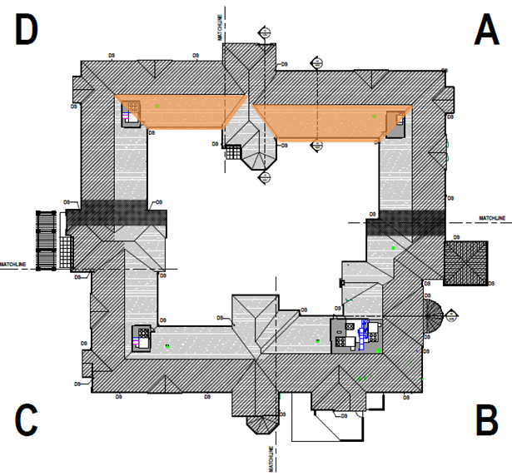

Installation of Solar Panels
Project Overview
Analysis 1: Prefabrication
Analysis 2: Solar Panel Installation
  Electrical Breadth
Analysis 3: SIPS
Analysis 4: Re-sequencing Project Schedule
Conclusion and Acknowledgements
Appendix
Background Information
Aesthetics and orientation
5324 SF of usable rooftop area
Roof truss system
EPDM roofing with composite asphalt shingles
3 Phase
208 Y/120 v
Usable rooftop area
*Courtesy of Hunzinger

Slide 13
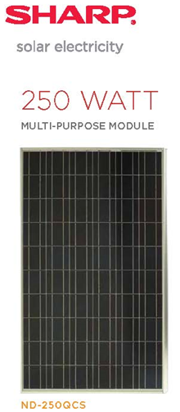
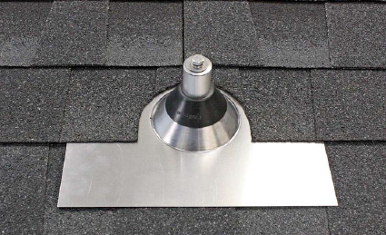

Installation of Solar Panels
Project Overview
Analysis 1: Prefabrication
Analysis 2: Solar Panel Installation
  Electrical Breadth
Analysis 3: SIPS
Analysis 4: Re-sequencing Project Schedule
Conclusion and Acknowledgements
Appendix
Components
Grid-tied system
5 strings of 11 modules (55 modules)
Selectria Renewables PVI 14 TL inverter with integrated string combiner
Quick Mount PV Classic Composition
Rooftrac racking system
60 A circuit breaker
Sharp ND-250QCS
Solectria Inverter
Quick Mount PV Classic Composition
www.quickmountpv.com
www.solren.com
www.prosolar.com
www.solren.com

Slide 14
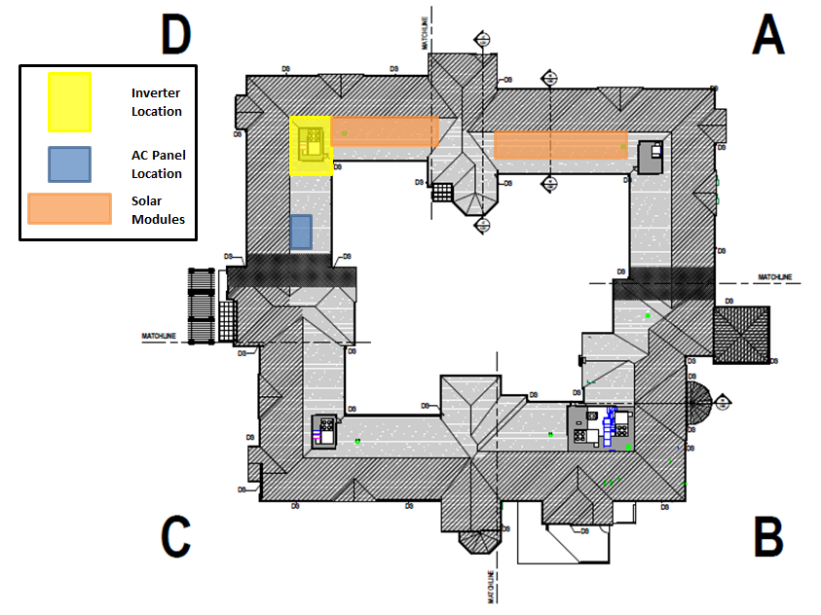
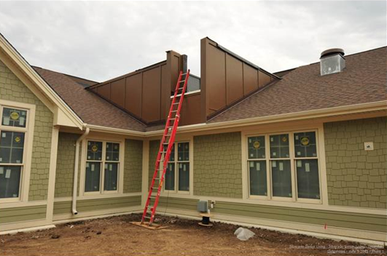
Installation of Solar Panels
Project Overview
Analysis 1: Prefabrication
Analysis 2: Solar Panel Installation
  Electrical Breadth
Analysis 3: SIPS
Analysis 4: Re-sequencing Project Schedule
Conclusion and Acknowledgements
Appendix
Component Placement
Quad A: 3 strings (33 modules)
Quad D: 2 strings (22 modules)
Inverter located in rooftop mechanical area in Quad D
AC panel and utility tie in located in RM D130.3
*Courtesy of Hunzinger
*Courtesy of Hunzinger

Slide 15
Installation of Solar Panels – Electrical Breadth
Project Overview
Analysis 1: Prefabrication
Analysis 2: Solar Panel Installation
  Electrical Breadth
Analysis 3: SIPS
Analysis 4: Re-sequencing Project Schedule
Conclusion and Acknowledgements
Appendix
Purpose
Additional equipment and optimal location
Shading impact
Electrical distribution
Payback period
LEED contribution

Slide 16
Installation of Solar Panels – Electrical Breadth
Project Overview
Analysis 1: Prefabrication
Analysis 2: Solar Panel Installation
  Electrical Breadth
Analysis 3: SIPS
Analysis 4: Re-sequencing Project Schedule
Conclusion and Acknowledgements
Appendix
Equipment
Module – Sharp ND-250QCS
      Max. Power 250 W
      Efficiency 15.3 %
      Max. Power Voltage 29.8 V
      Short Circuit Current 8.9 A
Inverter – PVI 14 TL
      Continuous Output Power 14 KW
      Efficiency 96.7 %
      Max. Open Circuit Voltage 600 V
      Continuous Output Current 39 A
Distribution
Module to Inverter (DC): #12 AWG THWN-2
Voltage Drop 1.8% < 3%
Inverter to Utility Connection (AC): #8 AWG THWN-2
Voltage Drop 1.6% < 2%

Slide 17
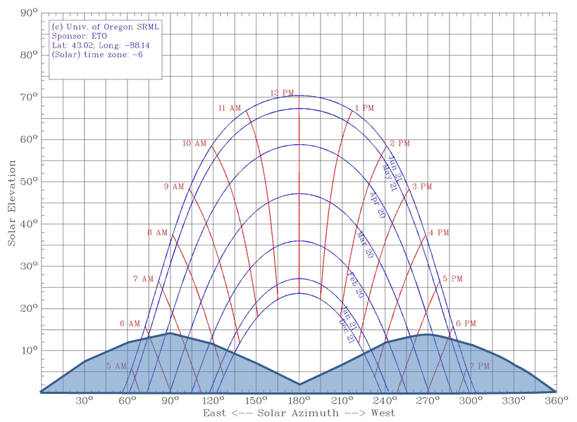
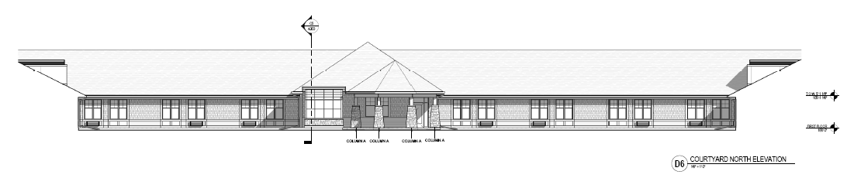
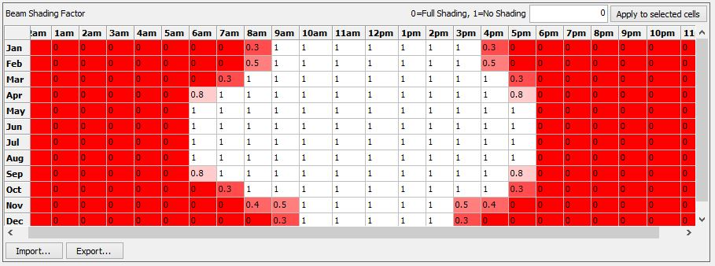
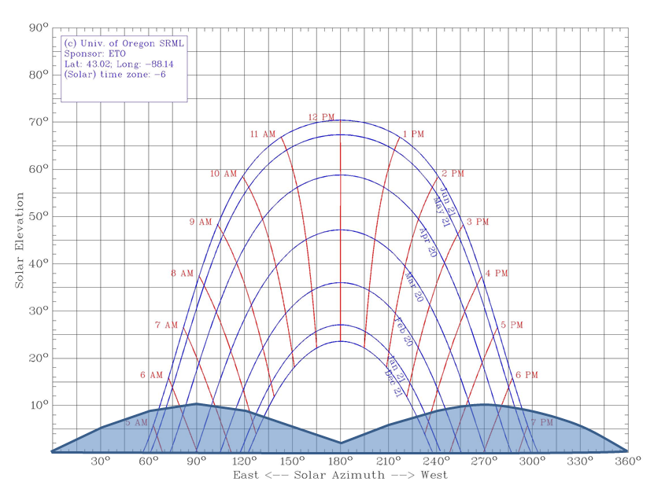
Installation of Solar Panels – Electrical Breadth
Project Overview
Analysis 1: Prefabrication
Analysis 2: Solar Panel Installation
  Electrical Breadth
Analysis 3: SIPS
Analysis 4: Re-sequencing Project Schedule
Conclusion and Acknowledgements
Appendix
Shading and Obstructions
*Courtesy of Hunzinger
Shading Charts for Milwaukee
www.solardat.uoregon.edu

Slide 18
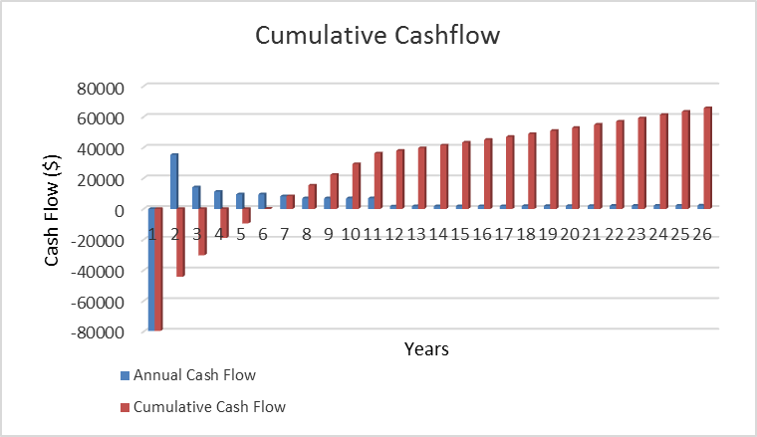
Installation of Solar Panels – Electrical Breadth
Project Overview
Analysis 1: Prefabrication
Analysis 2: Solar Panel Installation
  Electrical Breadth
Analysis 3: SIPS
Analysis 4: Re-sequencing Project Schedule
Conclusion and Acknowledgements
Appendix
Payback and LEED
6.2 years
Annual System Output: 15 (kWh)
Annual Energy Value: $3,110.95
30% Federal cash incentive
0.5 $/kwh State incentive for Wisconsin
1 point LEED contribution

Slide 19
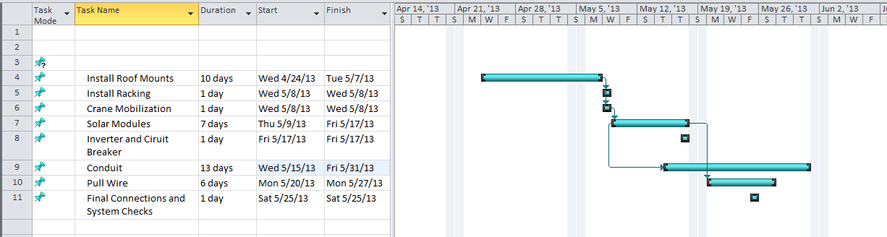
Installation of Solar Panels
Project Overview
Analysis 1: Prefabrication
Analysis 2: Solar Panel Installation
  Electrical Breadth
Analysis 3: SIPS
Analysis 4: Re-sequencing Project Schedule
Conclusion and Acknowledgements
Appendix
Schedule and Cost
291 labor hours
Constructability
Contractor availability
Equipment
Roof penetrations and obstacles
Warranty

Slide 20
Installation of Solar Panels
Project Overview
Analysis 1: Prefabrication
Analysis 2: Solar Panel Installation
  Electrical Breadth
Analysis 3: SIPS
Analysis 4: Re-sequencing Project Schedule
Conclusion and Acknowledgements
Appendix
Conclusion & Recommendation
It is recommended to install rooftop solar panels for this project.

Slide 21
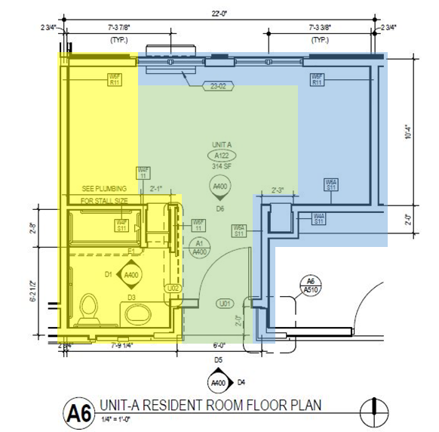
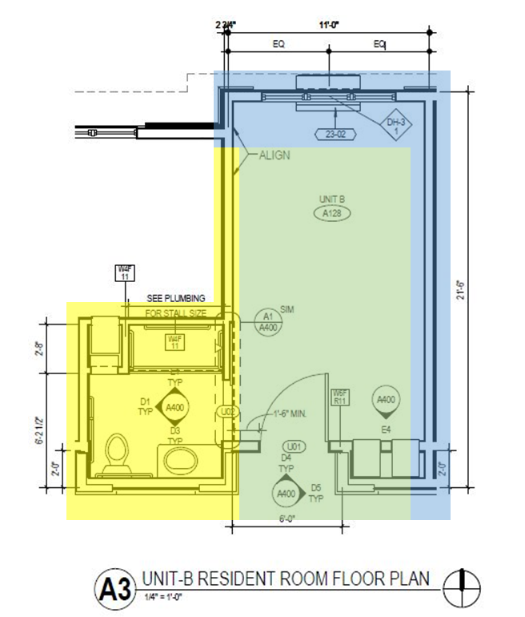
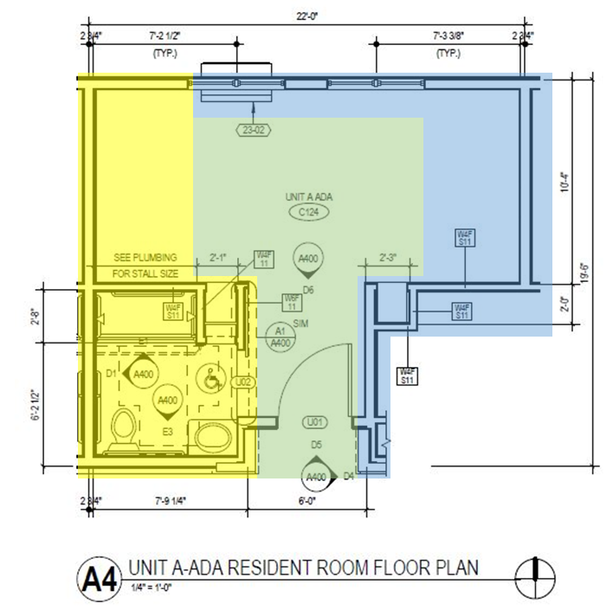
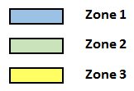
SIPS for Resident Rooms
Project Overview
Analysis 1: Prefabrication
Analysis 2: Solar Panel Installation
  Electrical Breadth
Analysis 3: SIPS
Analysis 4: Re-sequencing Project Schedule
Conclusion and Acknowledgements
Appendix
Background Information
50 sleeping units
3 layouts
96 days originally allotted for Mechanical, Electrical, Fire-Protection rough-in
Work progression
*Courtesy of Hunzinger

Slide 22
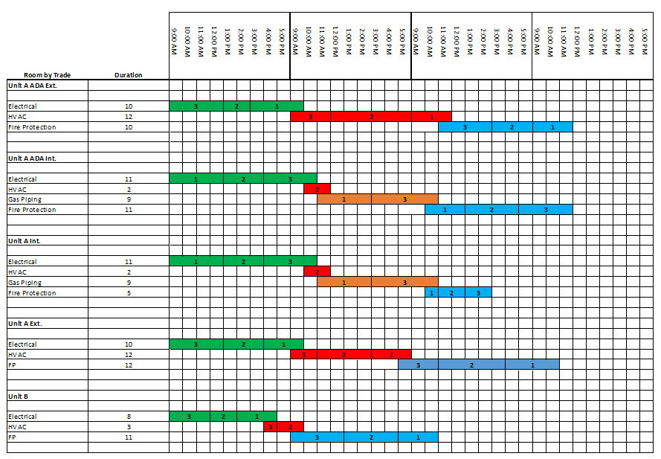
SIPS for Resident Rooms
Project Overview
Analysis 1: Prefabrication
Analysis 2: Solar Panel Installation
  Electrical Breadth
Analysis 3: SIPS
Analysis 4: Re-sequencing Project Schedule
Conclusion and Acknowledgements
Appendix
Durations and Sequence
Electrical → HVAC → Gas Piping → FP

Slide 23
SIPS for Resident Rooms
Project Overview
Analysis 1: Prefabrication
Analysis 2: Solar Panel Installation
  Electrical Breadth
Analysis 3: SIPS
Analysis 4: Re-sequencing Project Schedule
Conclusion and Acknowledgements
Appendix
Constructability Concerns
Early coordination
Higher congestion
Material and equipment staging areas
Expected delays
Cost Savings
Schedule reduction: 14 days
$31,000 cost savings from general conditions

Slide 24
SIPS for Resident Rooms
Project Overview
Analysis 1: Prefabrication
Analysis 2: Solar Panel Installation
  Electrical Breadth
Analysis 3: SIPS
Analysis 4: Re-sequencing Project Schedule
Conclusion and Acknowledgements
Appendix
Conclusion and Recommendation
It is recommended that SIPS is implemented on this project.

Slide 25
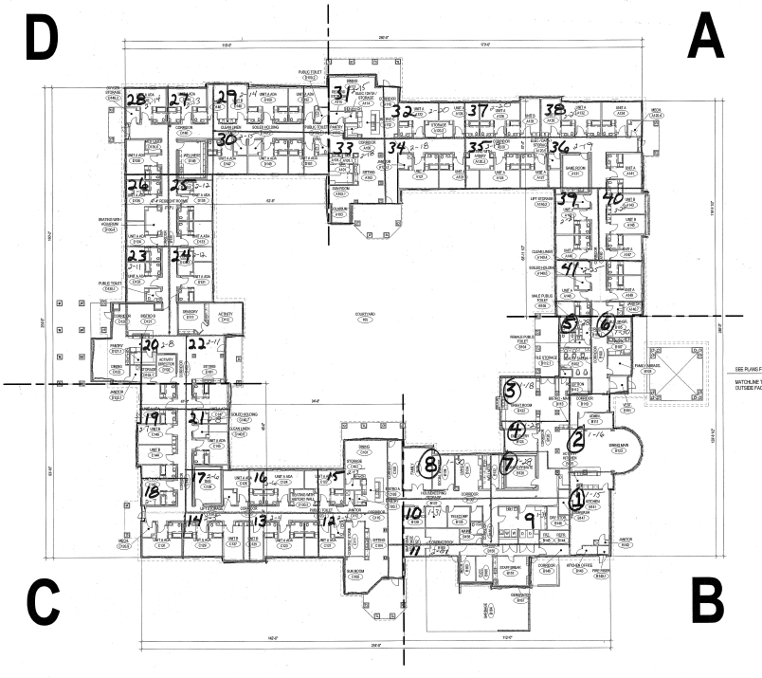
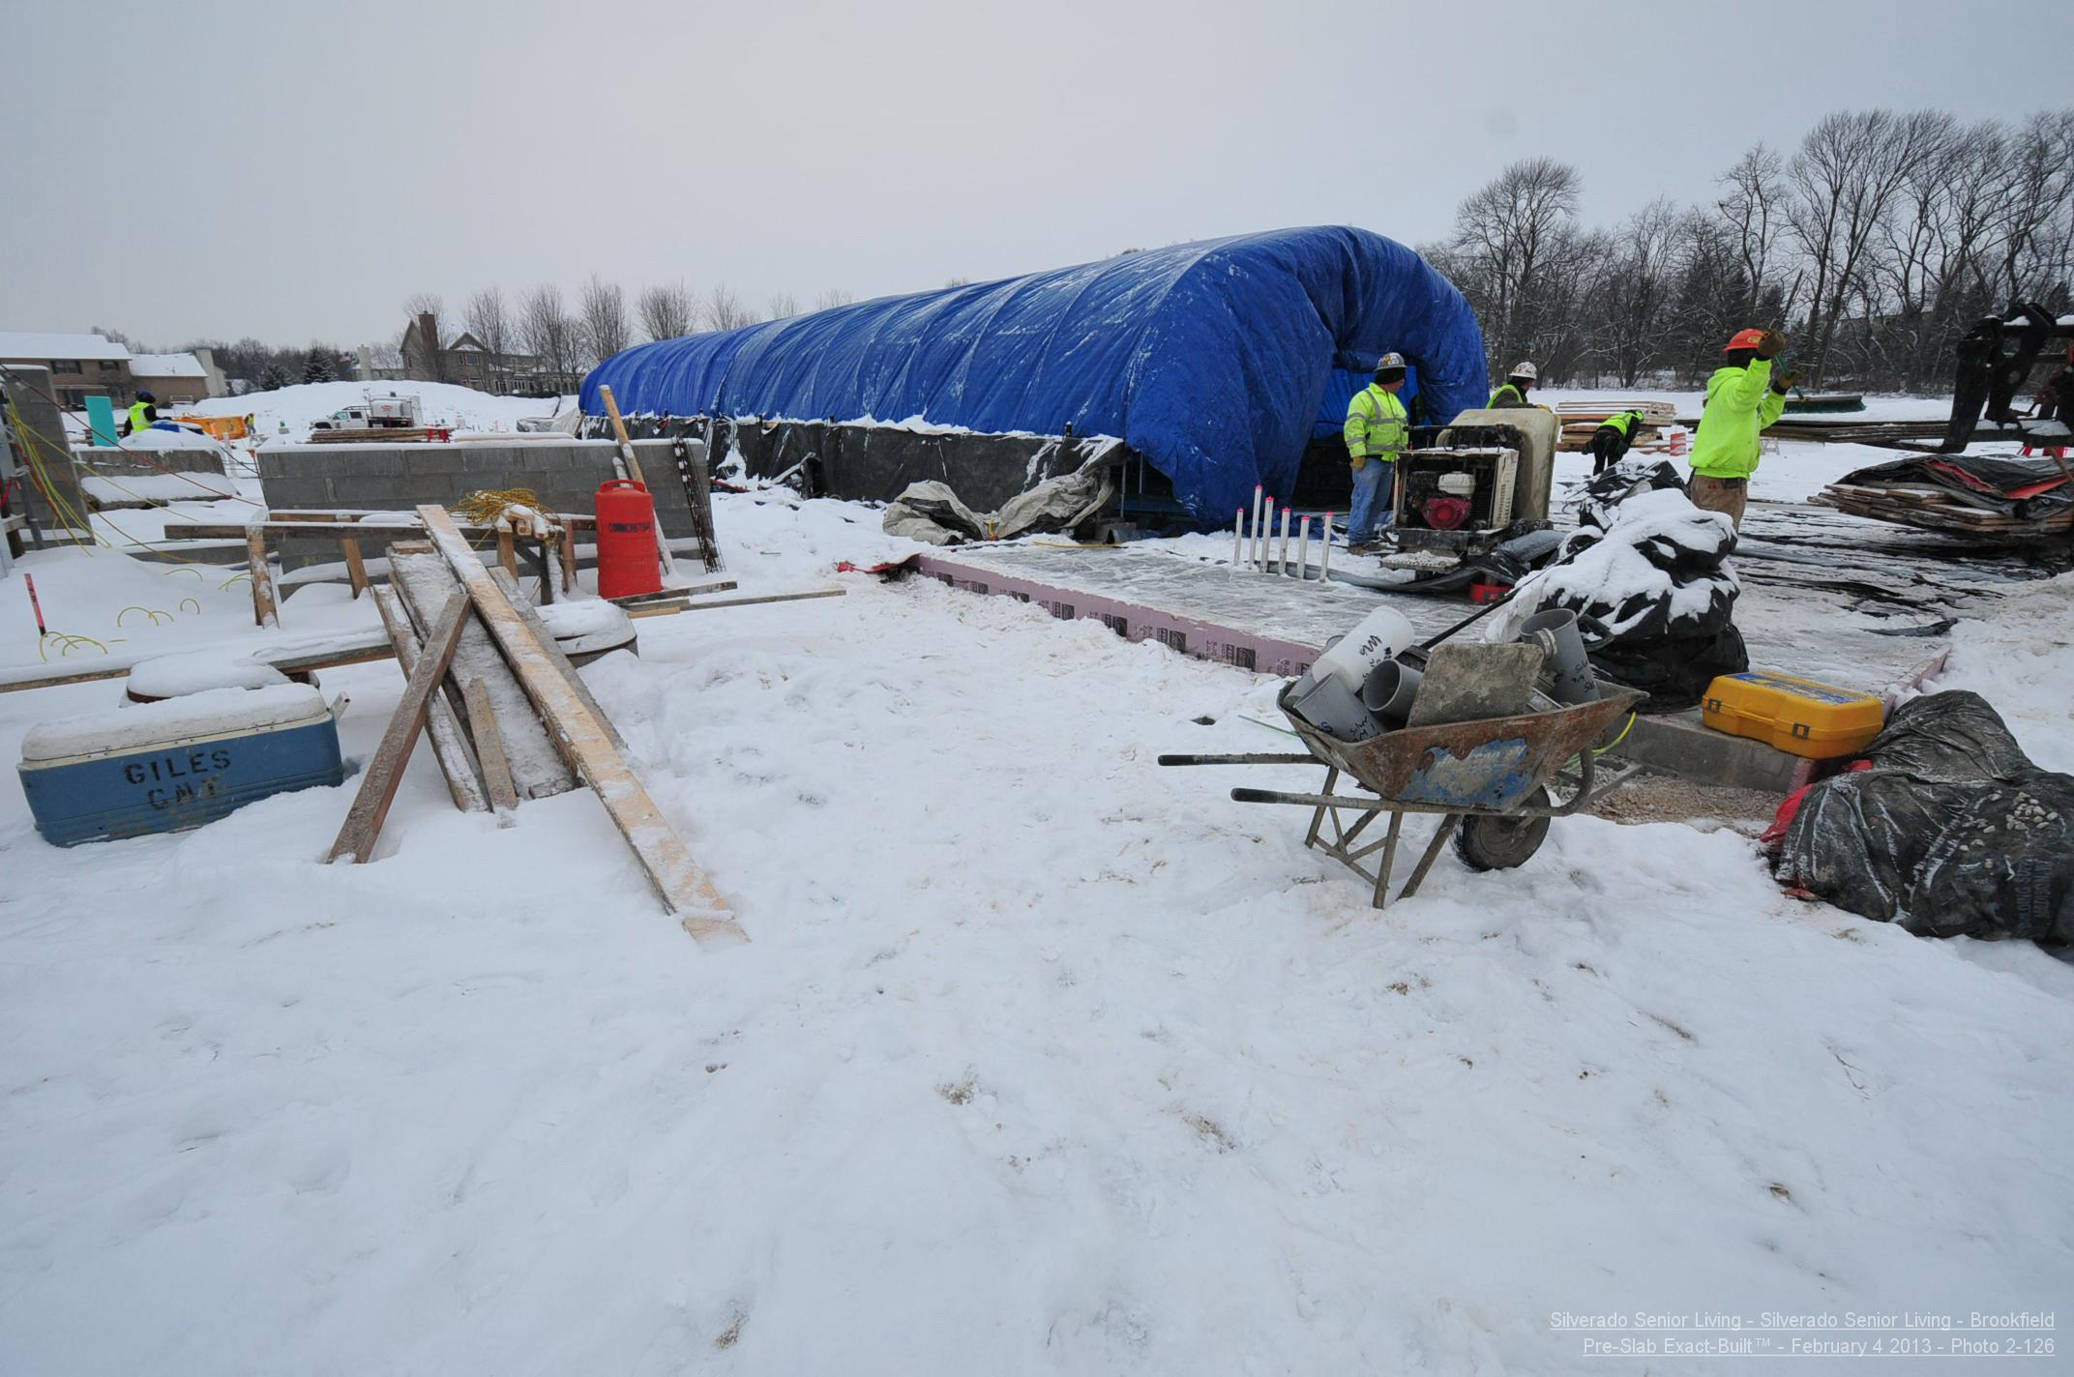
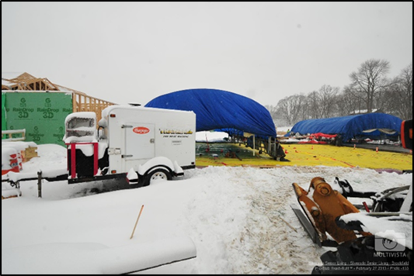
Re-sequencing of the Project Schedule
Project Overview
Analysis 1: Prefabrication
Analysis 2: Solar Panel Installation
  Electrical Breadth
Analysis 3: SIPS
Analysis 4: Re-sequencing Project Schedule
Conclusion and Acknowledgements
Appendix
Background Information
Slab on grade scheduled Jan 9 to March 1
$175,000 allotted for winter conditions
Critical path
*Courtesy of Hunzinger
Pour Sequence
*Courtesy of Hunzinger
*Courtesy of Hunzinger

Slide 26
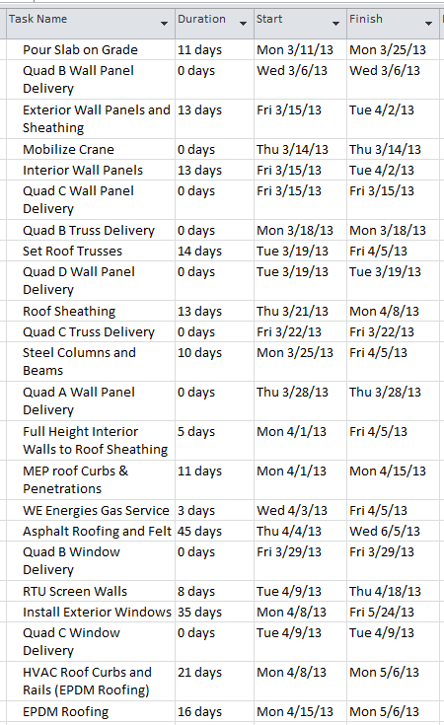
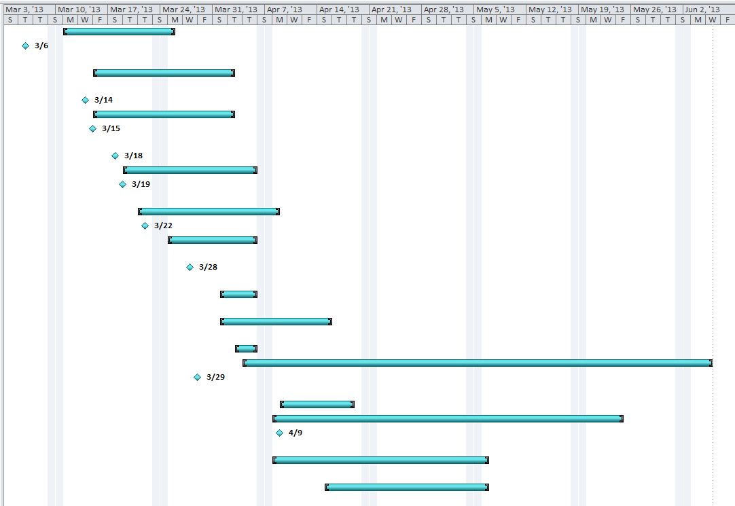
Re-sequencing of the Project Schedule
Project Overview
Analysis 1: Prefabrication
Analysis 2: Solar Panel Installation
  Electrical Breadth
Analysis 3: SIPS
Analysis 4: Re-sequencing Project Schedule
Conclusion and Acknowledgements
Appendix
Schedule Modifications
43 Days
Additional concrete crew
Overtime

Slide 27
Re-sequencing of the Project Schedule
Project Overview
Analysis 1: Prefabrication
Analysis 2: Solar Panel Installation
  Electrical Breadth
Analysis 3: SIPS
Analysis 4: Re-sequencing Project Schedule
Conclusion and Acknowledgements
Appendix
Cost Analysis
Labor and equipment
Quality control
Coordination

Slide 28
Re-sequencing of the Project Schedule
Project Overview
Analysis 1: Prefabrication
Analysis 2: Solar Panel Installation
  Electrical Breadth
Analysis 3: SIPS
Analysis 4: Re-sequencing Project Schedule
Conclusion and Acknowledgements
Appendix
Conclusion and Recommendation
It is not recommended to re-sequence the project schedule on this project.

Slide 29
Conclusion and Acknowledgements
Project Overview
Analysis 1: Prefabrication
Analysis 2: Solar Panel Installation
  Electrical Breadth
Analysis 3: SIPS
Analysis 4: Re-sequencing Project Schedule
Conclusion and Acknowledgements
Appendix
Final Conclusion
Analysis 1: It is not recommended to utilize prefabrication as a means of achieving a reduction in schedule.
Analysis 2: It is recommended to install rooftop solar panels
Analysis 3: It is recommended that SIPS is implemented on this project.
Analysis 4: It is not recommended to re-sequence the project schedule on this project.

Slide 30

Conclusion and Acknowledgements
Project Overview
Analysis 1: Prefabrication
Analysis 2: Solar Panel Installation
  Electrical Breadth
Analysis 3: SIPS
Analysis 4: Re-sequencing Project Schedule
Conclusion and Acknowledgements
Appendix
Acknowledgements
Dr. Ed Gannon
Professor Parfitt
Dr. Leicht
Penn State AE Faculty
Industry
Special Thanks
James R. Hunzinger –Executive Vice President
Jon Sheahan –Senior Project Manager
Tim Verheyen –VDCC Coordinator, Senior Estimator
Jim Callen –Field Superintendent
PACE Industry Members
Family and Friends

Slide 31
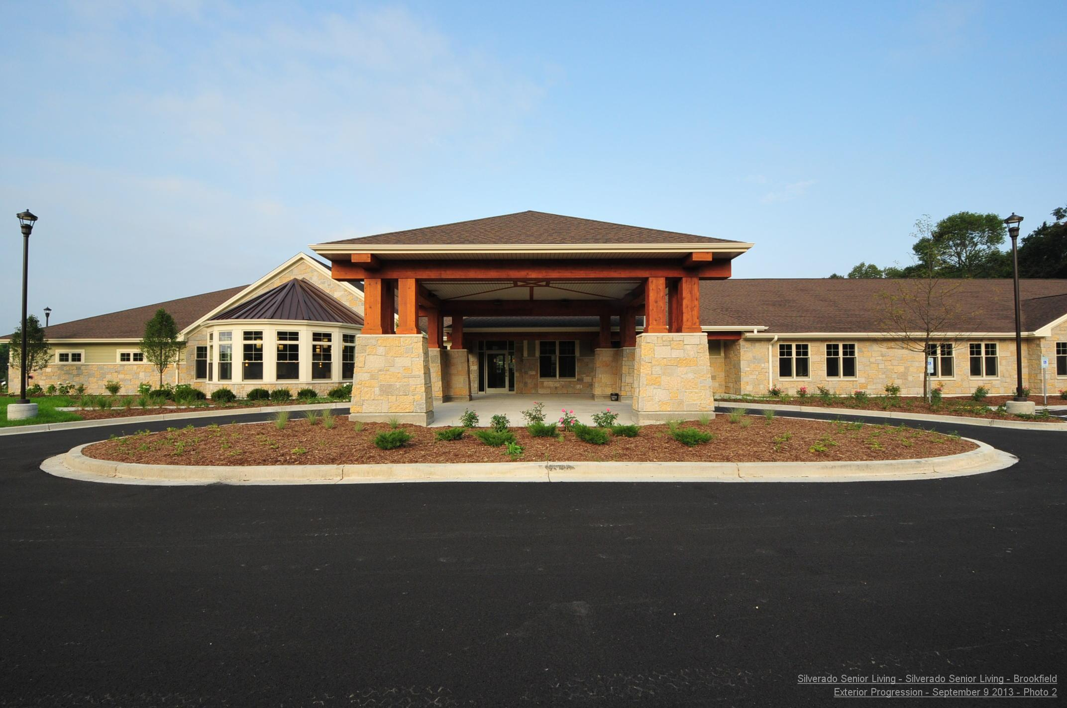
Conclusion and Acknowledgements
Project Overview
Analysis 1: Prefabrication
Analysis 2: Solar Panel Installation
  Electrical Breadth
Analysis 3: SIPS
Analysis 4: Re-sequencing Project Schedule
Conclusion and Acknowledgements
Appendix
Questions?
*Courtesy of Hunzinger

Slide 32
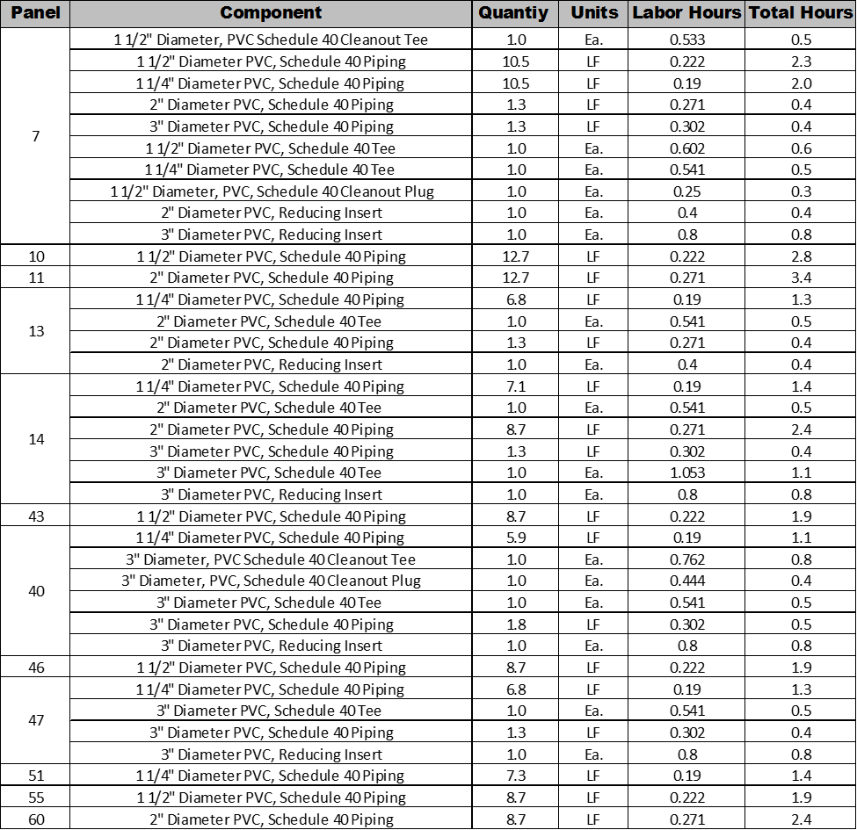
Appendix
Project Overview
Analysis 1: Prefabrication
Analysis 2: Solar Panel Installation
  Electrical Breadth
Analysis 3: SIPS
Analysis 4: Re-sequencing Project Schedule
Conclusion and Acknowledgements
Appendix
Quad B Wall Panel Plumbing Take-offs

Slide 33
Appendix
Project Overview
Analysis 1: Prefabrication
Analysis 2: Solar Panel Installation
  Electrical Breadth
Analysis 3: SIPS
Analysis 4: Re-sequencing Project Schedule
Conclusion and Acknowledgements
Appendix
Quad B Wall Panel Plumbing Take-offs
Conductor Sizing Take-offs
DC Circuit Conductors
Isc = Rated short circuit current = 8.9 A @ 90°C
Required Ampacity for solar circuit = 1.25 x 1.25 x 8.9 = 13.9 Amps → #12 AWG✓
Adjustment for Conduit Fill
  5 conductors = .80 derating factor → #12 AWG
  13.9 Amps/.80 = 17.375 A → #12 AWG ✓
Adjustment for Ambient Temperature (90°F for Milwaukee)
  Factor = .96
  Adjusted Ampacity = 17.375 Amp x .96 = 16.69 Amps
  Adjustment for height above roof
  ½” to 3.5” → 40°F rise in ambient temperature
  134° → Factor = .71
  Needed Ampacity = .71 x .80 x 30 A = 17.04 Amp
#12 AWG THWN-2 rating 30 Amp @ 90°C > 17.04 Amp → #12 AWG ✓

Slide 34
Appendix
Project Overview
Analysis 1: Prefabrication
Analysis 2: Solar Panel Installation
  Electrical Breadth
Analysis 3: SIPS
Analysis 4: Re-sequencing Project Schedule
Conclusion and Acknowledgements
Appendix
Conductor Sizing Take-offs
AC (Inverter to Utility) Circuit Conductors
Min Ampacity = 39 A x 1.25 = 48.75 Amps A → #8 AWG ✓
Conduit Fill → 5 Conductors = .80 derating factor
Ambient Temperature→ .96
Height above roof (1/2” – 3.5”) ” → 40°F rise in ambient temperature →
New Factor = .71
Needed Ampacity = 55 Amps x .80 x .71 = 31.24 Amps
#8 AWG THWN-2 rating → 55 Amp @ 90°C > 31.24 Amp → #8 AWG ✓
Conductor Sizing Take-offs
Voltage Drop DC
VD = 1.732 x L x R x I / 1000
Vpm = 29.8 V x 11 modules in series = 327.8 Volts
Imp = 8.4 A, R (#12 AWG)=5.320 ohm/km, L = 80’ max length
VD = {2 x 80’ max length x 5.230 ohm/km x 8.4 A} / 1000 = 6.19 Volts
6.19 V/327.8 V = 1.8% Voltage drop < 3% ✓
Voltage Drop AC
VD = 1.732 x L x R x I / 1000
Vpm = 29.8 V x 11 modules in series = 208 Volts
I = 39 A, R (#8 AWG) = 0.6401 ohm/km, L = 75’ max length
VD = {1.732 x 75’ max length x 0.6401 ohm/km x 39 A} / 1000 = 3.24 Volts
3.24 V/208 V = 1.6% Voltage drop < 2% ✓

Slide 35
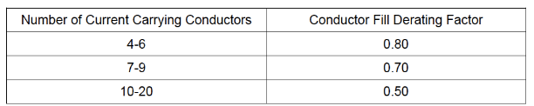
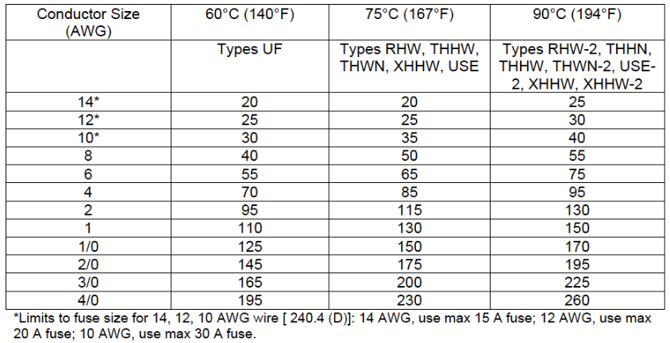
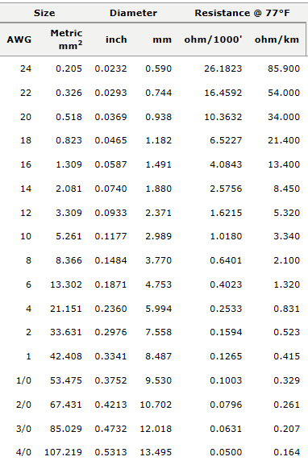
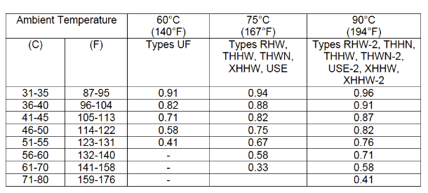
Appendix
Project Overview
Analysis 1: Prefabrication
Analysis 2: Solar Panel Installation
  Electrical Breadth
Analysis 3: SIPS
Analysis 4: Re-sequencing Project Schedule
Conclusion and Acknowledgements
Appendix
Electrical Design Tables
Electrical Design Tables

Slide 36
Appendix
Project Overview
Analysis 1: Prefabrication
Analysis 2: Solar Panel Installation
  Electrical Breadth
Analysis 3: SIPS
Analysis 4: Re-sequencing Project Schedule
Conclusion and Acknowledgements
Appendix
Labor Durations for Solar Panels
      S
SIPS Labor Durations by Room

